Slide 1
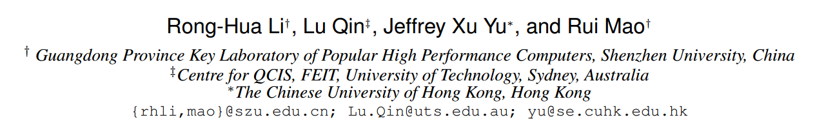
Efficient and Progressive Group Steiner Tree Search
SIGMOD-2016
TianzhuWei
2016/10/??

Slide 2
Contents
Problem definition
Exist Solution
Our Solution
Experiments
Thinking

Slide 3
The GST Problem
Given a weighted and labelled graph G =(V; E)
1
1
a subset of labels P ( P ⊆ S )
the GST problem seeks to find the minimum weight connected from G that includes all the labels in P
4
4
4
4
4
4
每一个结点都有含有多个标签
1
1
1
1
1
1
v1
v2
v3
v4
4
4
1
1
1
1
v1
v2
v3
v4

Slide 4
Exist Solution
1
1
The parameterized DP algorithm
Edge growing operation
T(v,p)
v
4
4
4
4
4
4
u
T(u,p)
1
1
1
1
p
v1
v2
v3
v4
Tree merging operation
v
T(v,p₂)
v
T(v,p)
p₂
p
v
T(v,p₁)
p₁

Slide 5
优先队列
按照入队子树的权重和进行排列，权重越小，优先值越高
1
v9
1
v7
v8
v1
v2
v3
v4
4
4
4
4
4
4
初始情况下将含有标签的结点看成是一个单个结点的树，权重为 0
v5
v6
1
1
1
1
v3
v4
v1
v2
v3
v4
v5
v5
v6
v6
v7
v7
v8
v8
1
1
1
1
4
4
4
4
v1
v2
v3
v4
v1
v2
v3
v4
v5
缺点：First, the time complexity
Second,the algorithm only generates a solution when it terminates
1
4
v1
v2

Slide 6


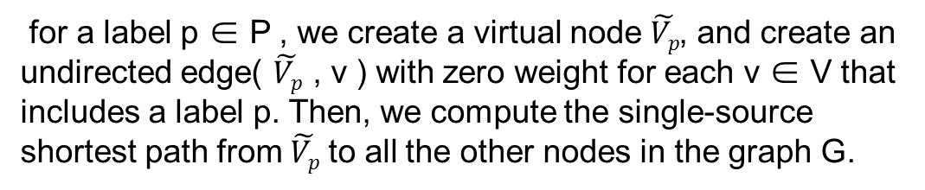



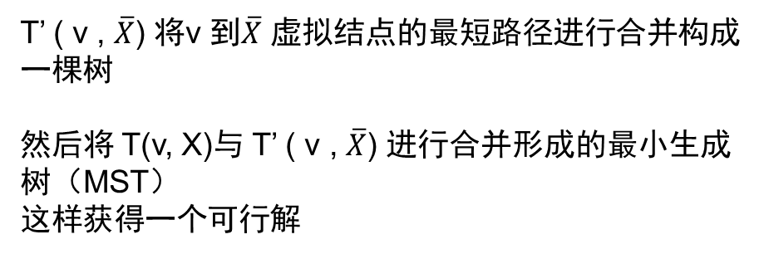
1
v9
1
The Basic algorithm
v7
v8
Preprocessing
4
4
4
4
4
4
for a label p ∈ P , we create a virtual node $\tilde{Vp}$, and create an undirected edge( $\tilde{Vp}$ , v ) with zero weight for each v ∈ V that includes a label p. Then, we compute the single-source shortest path from $\tilde{Vp}$ to all the other nodes in the graph G.
v5
v6
1
1
1
1
v1
v2
v3
v4
使用 Dijkstra 方法求解 $\tilde{Vp}$ 到其它 V 结点的最短路径
$$\overline{X}= P\backslash X$$
$\tilde{Vp}$1
$\tilde{Vp}$2
$\tilde{Vp}$4
T’ ( v , $\overline{X}$) 将v 到$\overline{X}$ 虚拟结点的最短路径进行合并构成一棵树
然后将 T(v, X)与 T’ ( v , $\overline{X}$) 进行合并形成的最小生成树（MST）
这样获得一个可行解
$\tilde{Vp}$3

Slide 9
Thanks

